Slide 1
Airbnb
London
Analysis
SHUBHAM NATH
nath725shubham@gmail.com
+91-7972441336

Slide 2
Overview
Data source : http://insideairbnb.com/ [9 Feb, 2021 London Archives]
Content: Listings and Reviews
Analysis:
Wrangling
&
Exploring
Review
Sentiment
Analysis
Price
Prediction

Slide 3
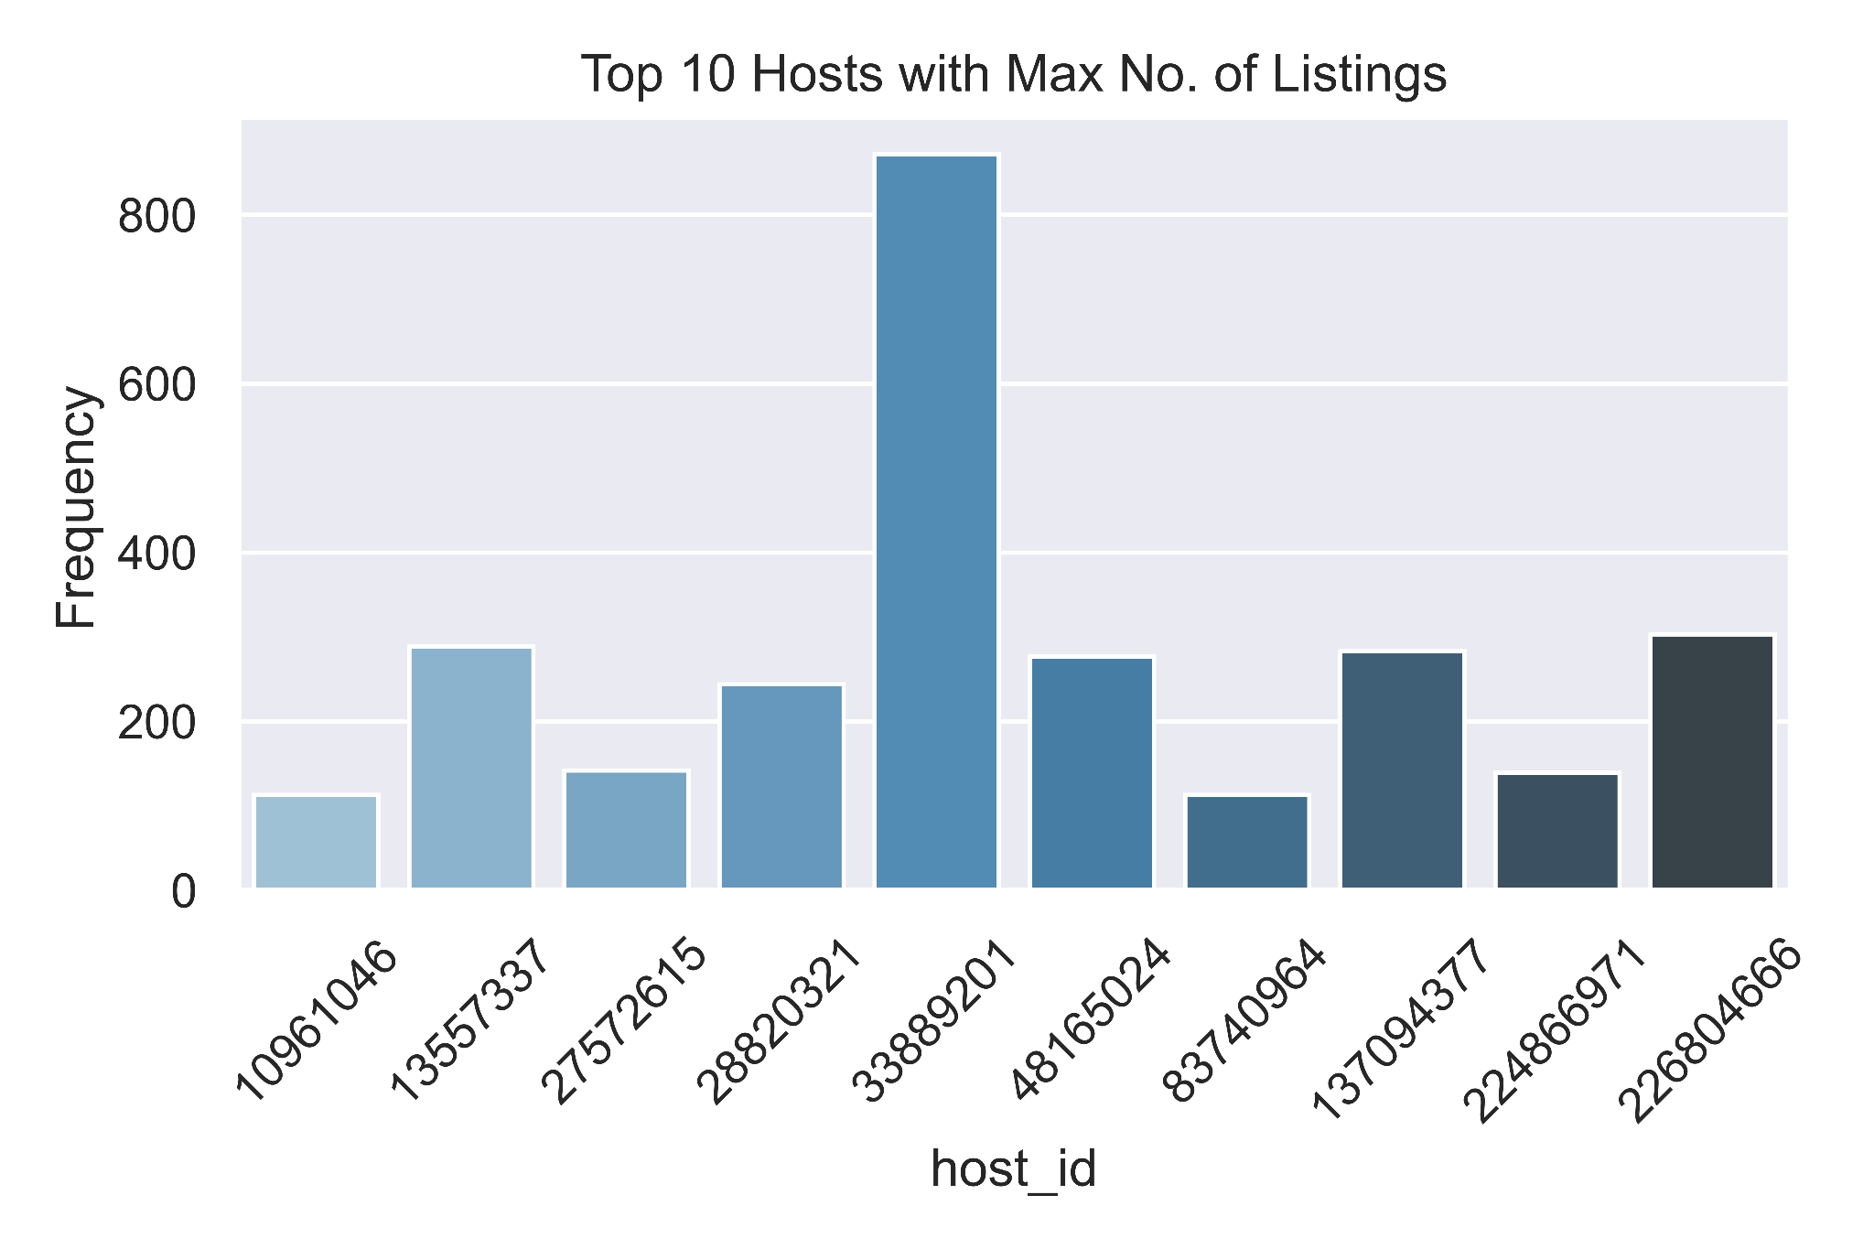
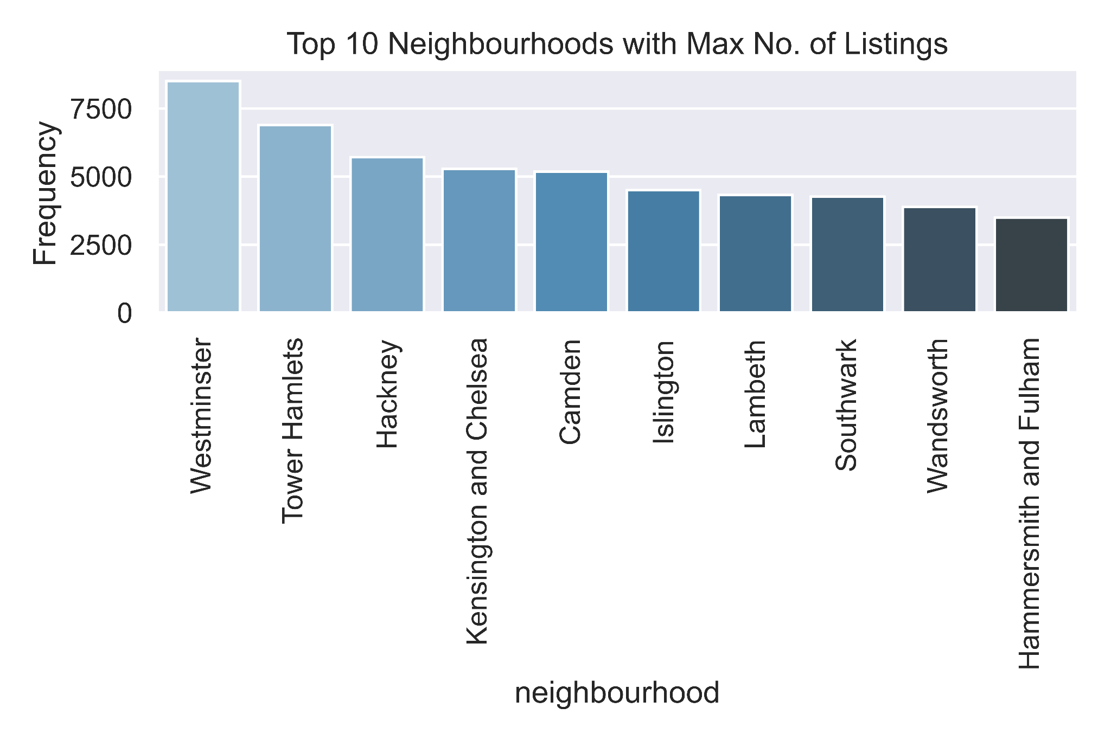
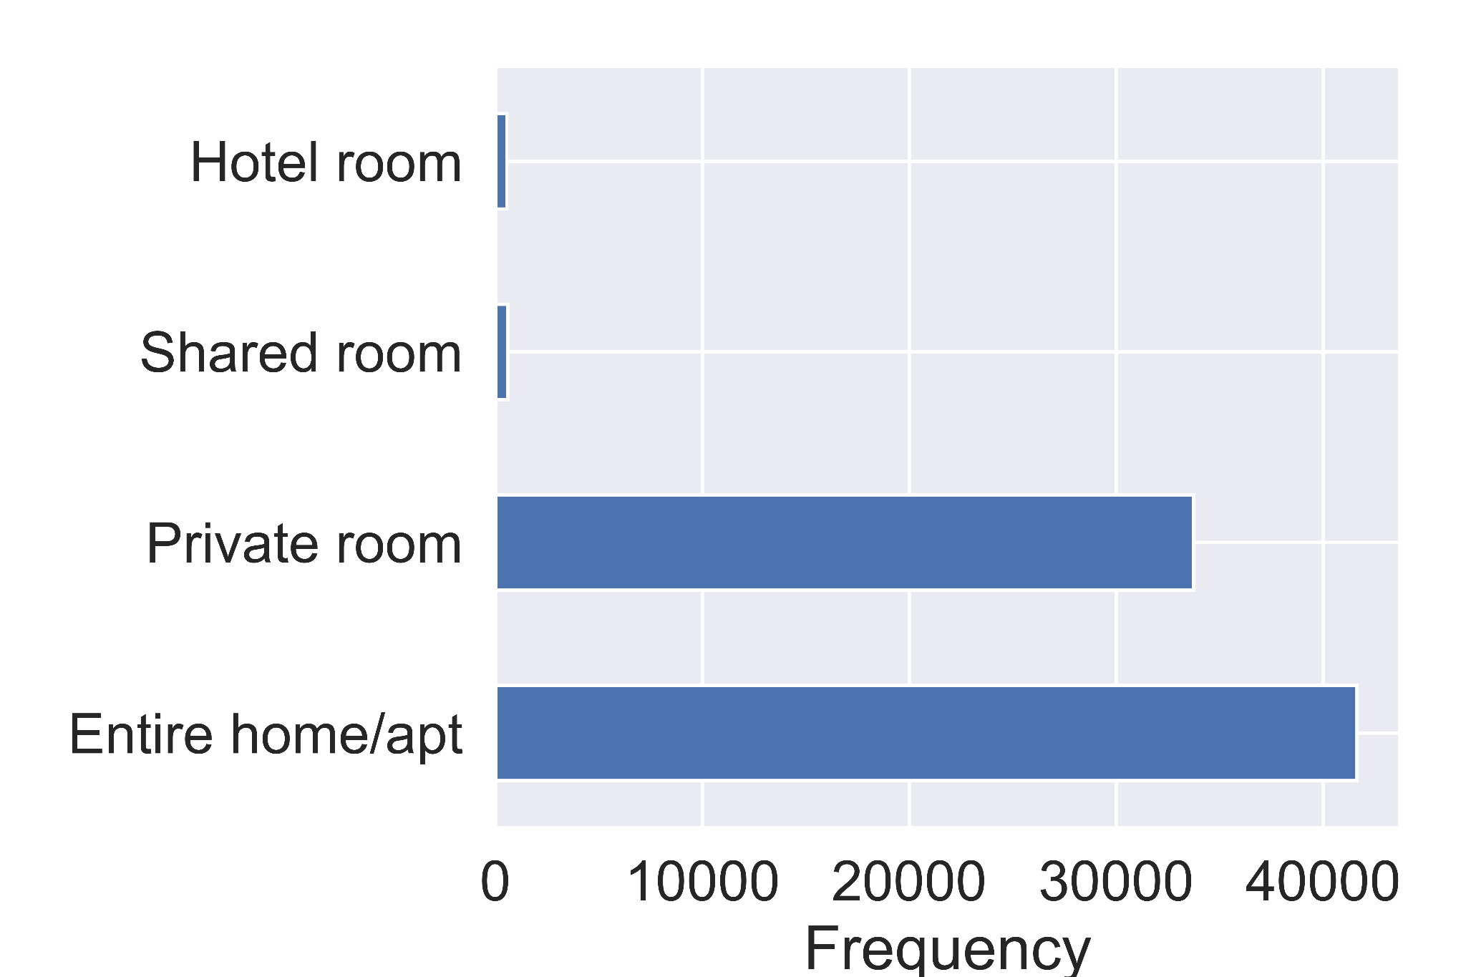
Wrangling and Exploring Data
Neighbourhood_group column is 100% missing, hence removed.
Last_review column’s missing values have been imputed by 0. Assumption: there are no reviews for those listings
Name identifiers have been removed since we have ids if needed
INSIGHTS:
Host 33889201 outmatches others by a lot (800+ listings)
Westminster is the neighbourhood with the most listings
Most listings are of the type: Entire home/apt or Private room
Notes:
Top10 neigh, top 10 hosts,room type,box plots,violin plots,spatial data

Slide 4
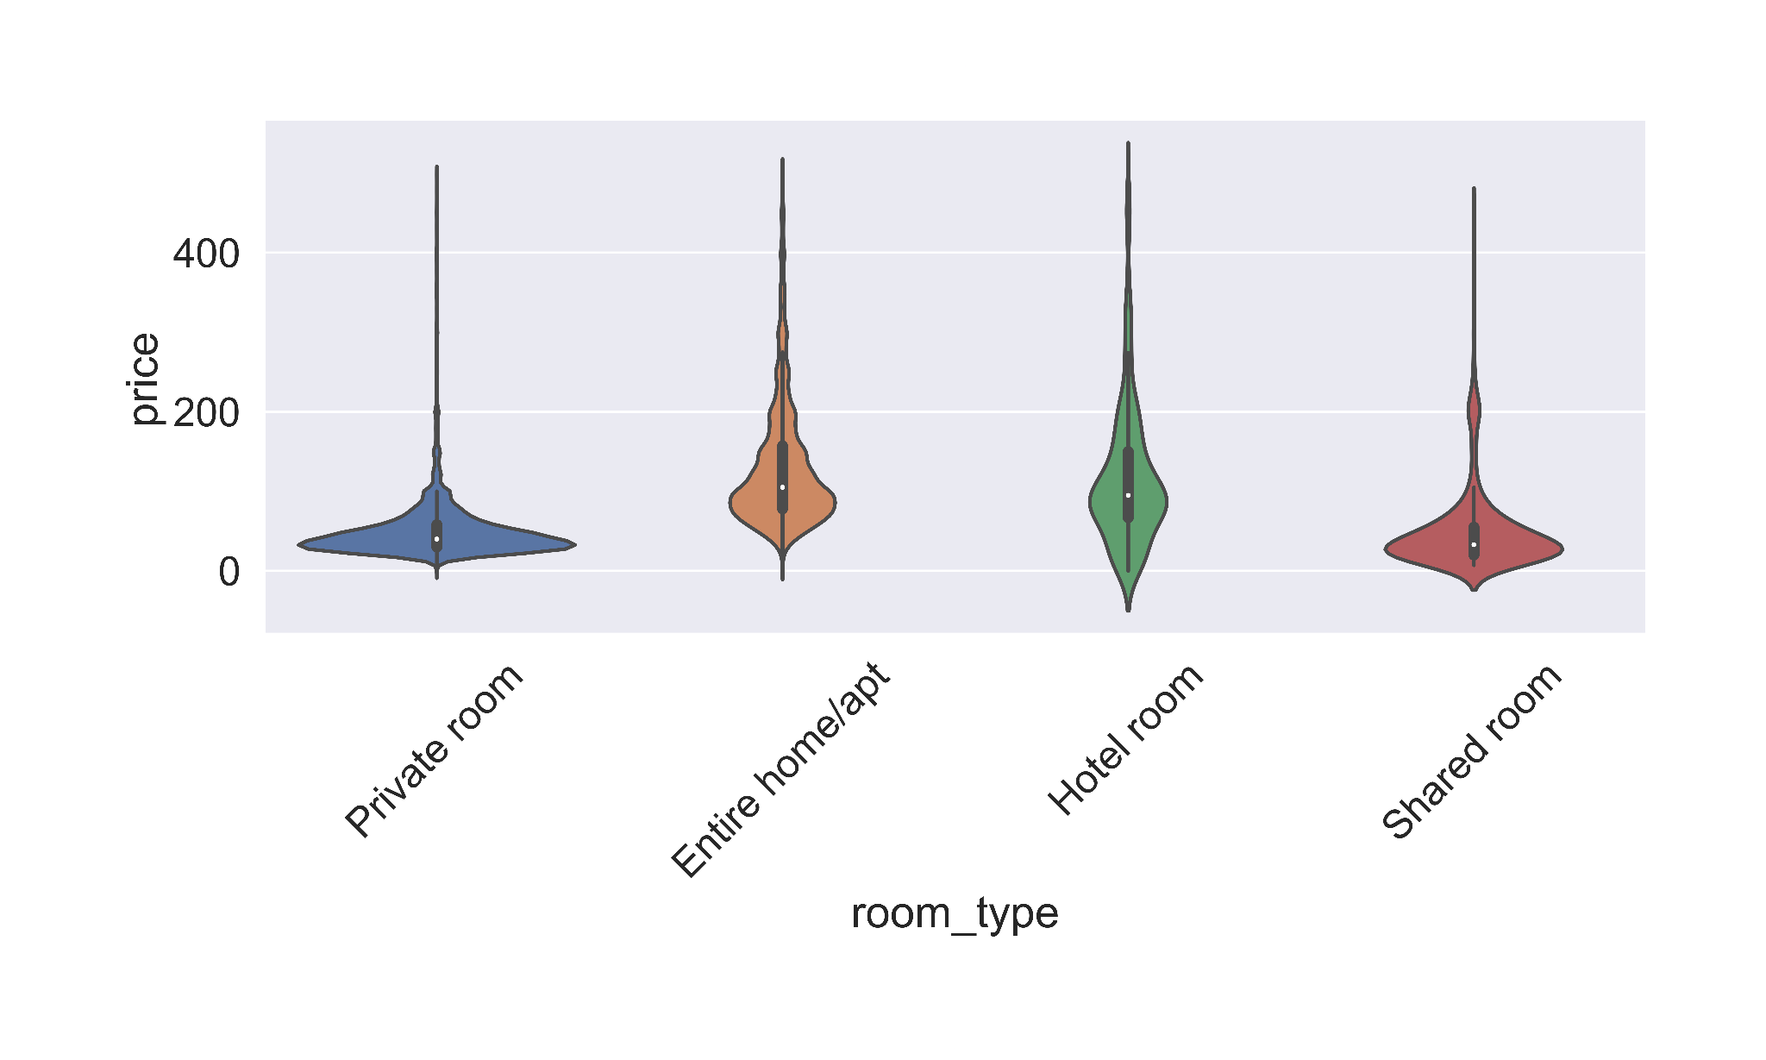
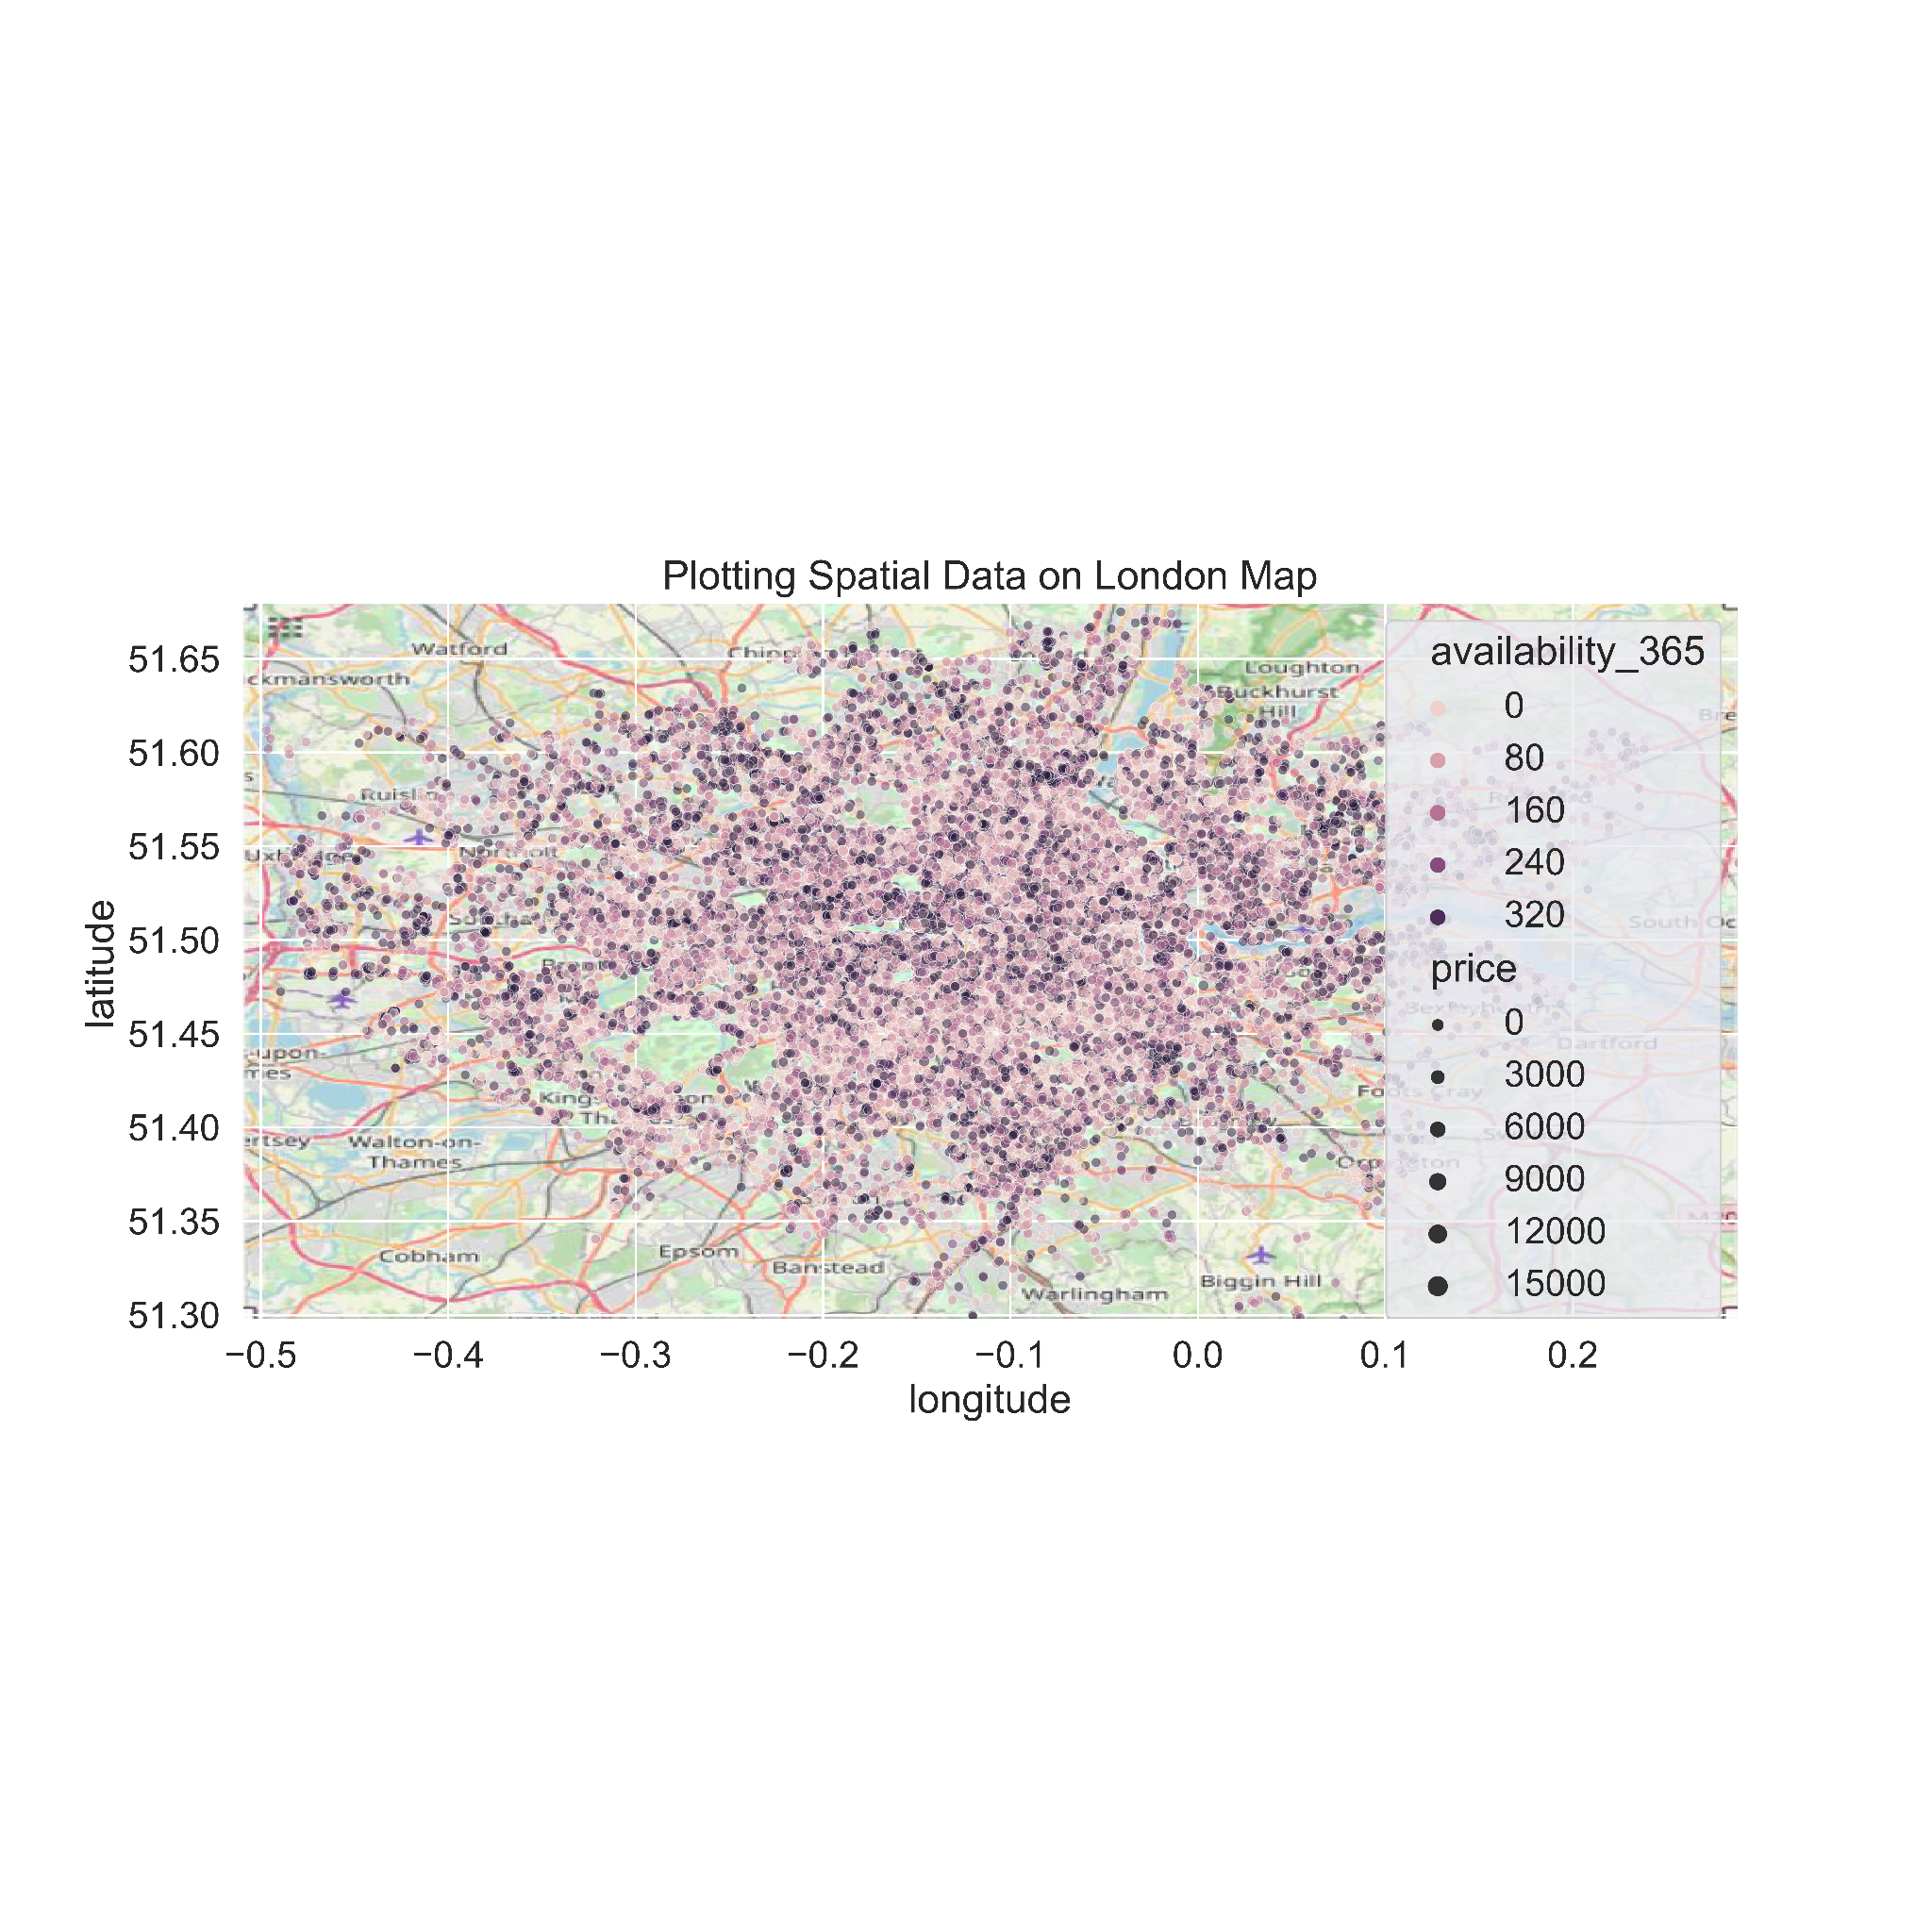
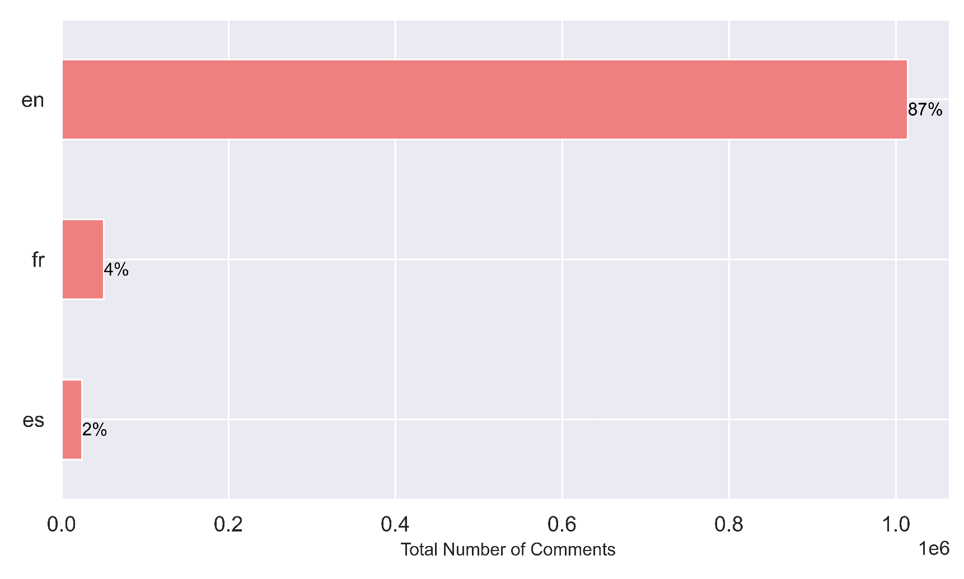

Price, no. of reviews and minimum nights are highly skewed
For a better visualization, we remove extreme values of price during bivariate analysis.
INSIGHTS:
Hotel rooms have the highest range in prices, closely followed by Entire home/apt.
In general,Hotel rooms and Entire home/apt are more expensive than Shared or Private rooms
Listings in central London have, in general, high availability
Most reviews are in English language out of 44 total languages
Top 3 Most Used Review Languages
Price

Slide 5
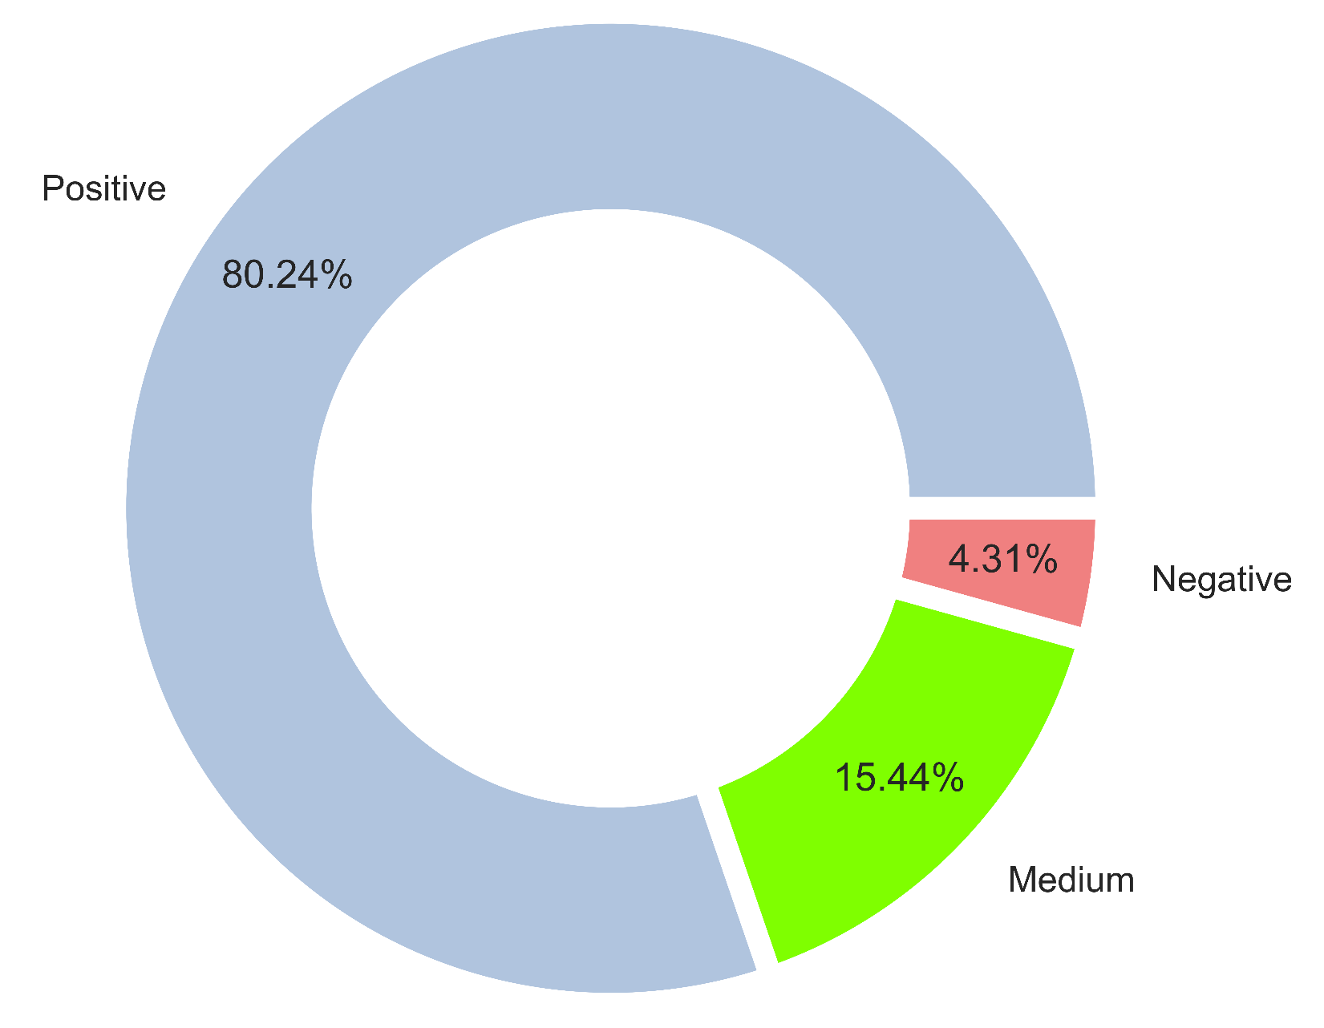
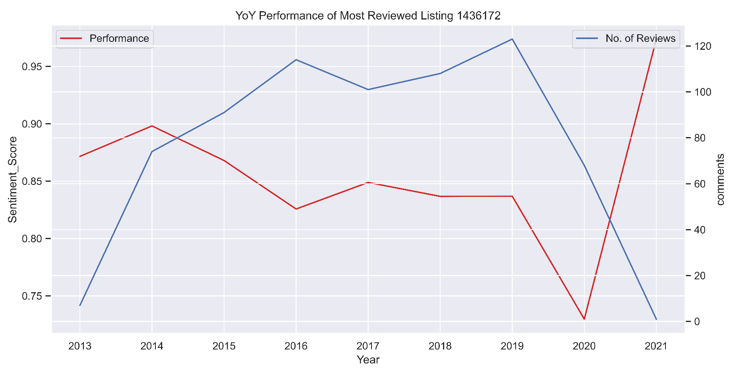
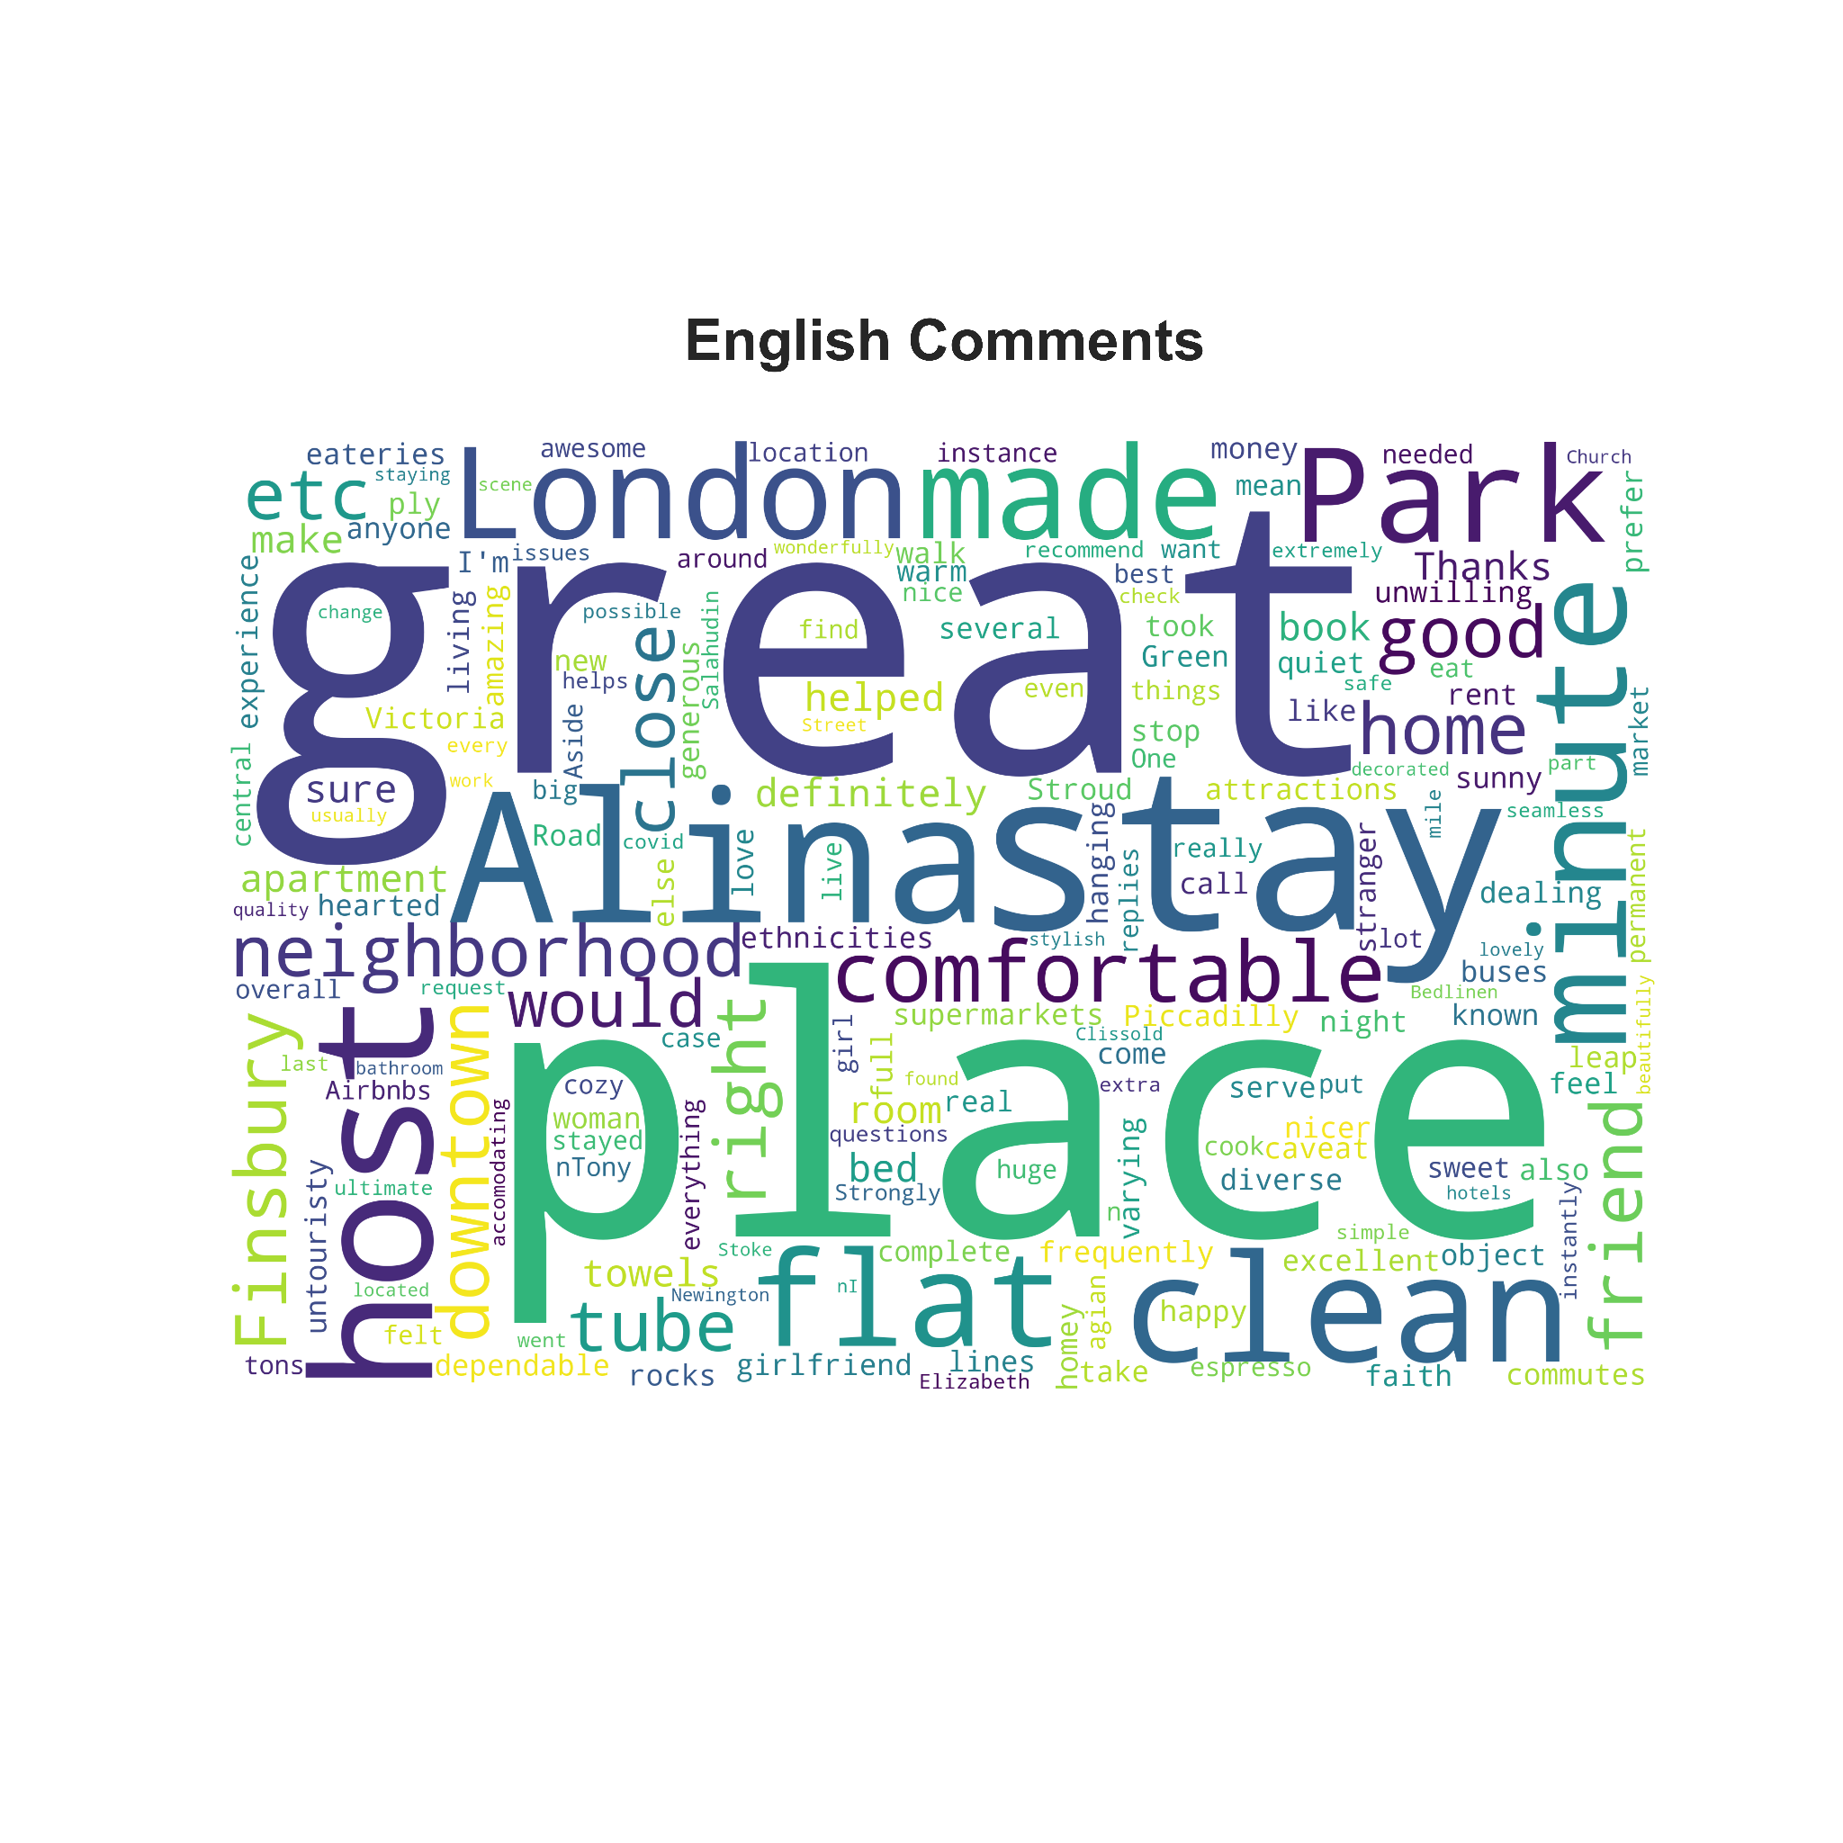
Review Sentiment Analysis
Business Use Case : Ease of processing feedback from customers
Methodology : Unsupervised learning English comments using Vader
Created variable : Sentiment Score (Range: -1 to 1, measuring positive/negative/neutral sentiment)
Bucketed Score as per industry standards to label sentiments as positive, medium, or negative.
INSIGHTS:
Most comments are positive
People like when the place is clean and comfortable the host is friendly and the neighbourhood is centrally located.
Performance of most reviewed listing dropped in 2020 probably due to Covid
Highest Scored Listing-99241. Highest Scored Host- The Portobello Room
Note- Only considered listings, hosts with at least 50 reviews for point 4.
Most Frequent Words in Positive Comments

Slide 6
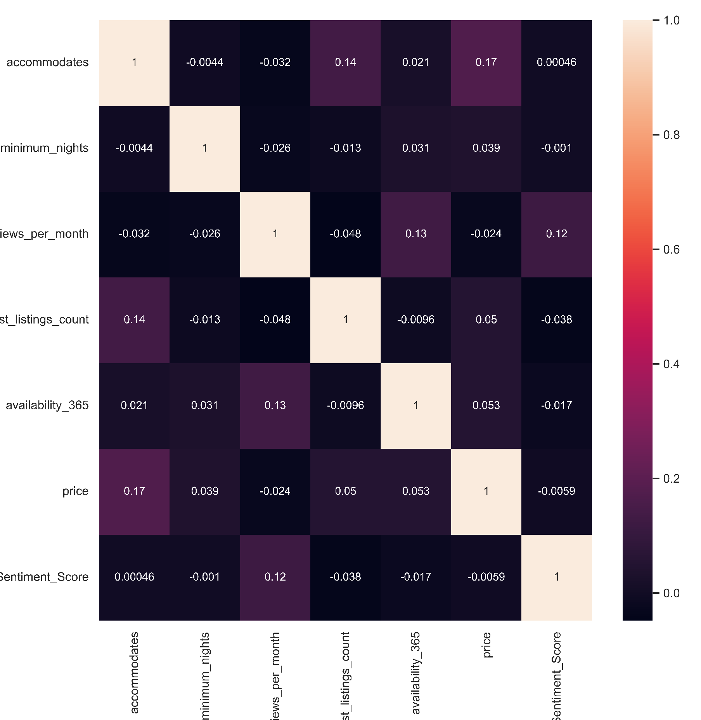
Price Prediction Model
Business Use Case : Predict price for a new listing based on variables in multiple datasets
Methodology : Supervised Learning (Regression Analysis)
Feature engineered variable: Avg_Sentiment_Score_Per_Listing using Score from sentiment analysis
Experimented with different models and picked best. Performed Hyperparameter Tuning to get best set of parameters
Variables Used:
Accommodates
Avg_Sentiment_Score
Neighbourhood
Room Type
Calculated Host Listings Count
Host Identity Verified
Host superhost
Instant Bookable
Minimum Nights
Reviews Per Month
Availability 365
Validation RMSE:
249
Train RMSE:
159
Correlation Heatmap of Variables left after removing multicollinearity
Notes:
Top10 neigh, top 10 hosts,room type,box plots,violin plots,spatial data,| sentiment: word cloud, year on year peformance | price prediction: correlation, variables used, model performance table, accuracy|

Slide 7
Future Prospects
Thank You !
Time Series Forecasting For Price or Availability
Using Listings and Review Data for training and Calendar data for validation
Using neural network architectures for price prediction.
Utilizing the power of Deep Learning to decrease validation errors
Trying Supervised Sentiment Analysis by using Review Scores present in data as a proxy for Sentiment Scores
To improve sentiment model

